Slide 1



AdventureWorks Reports
View in Power BI
Last data refresh:
11/2/2025 7:17:43 PM UTC
Downloaded at:
11/2/2025 7:47:52 PM UTC

Slide 2
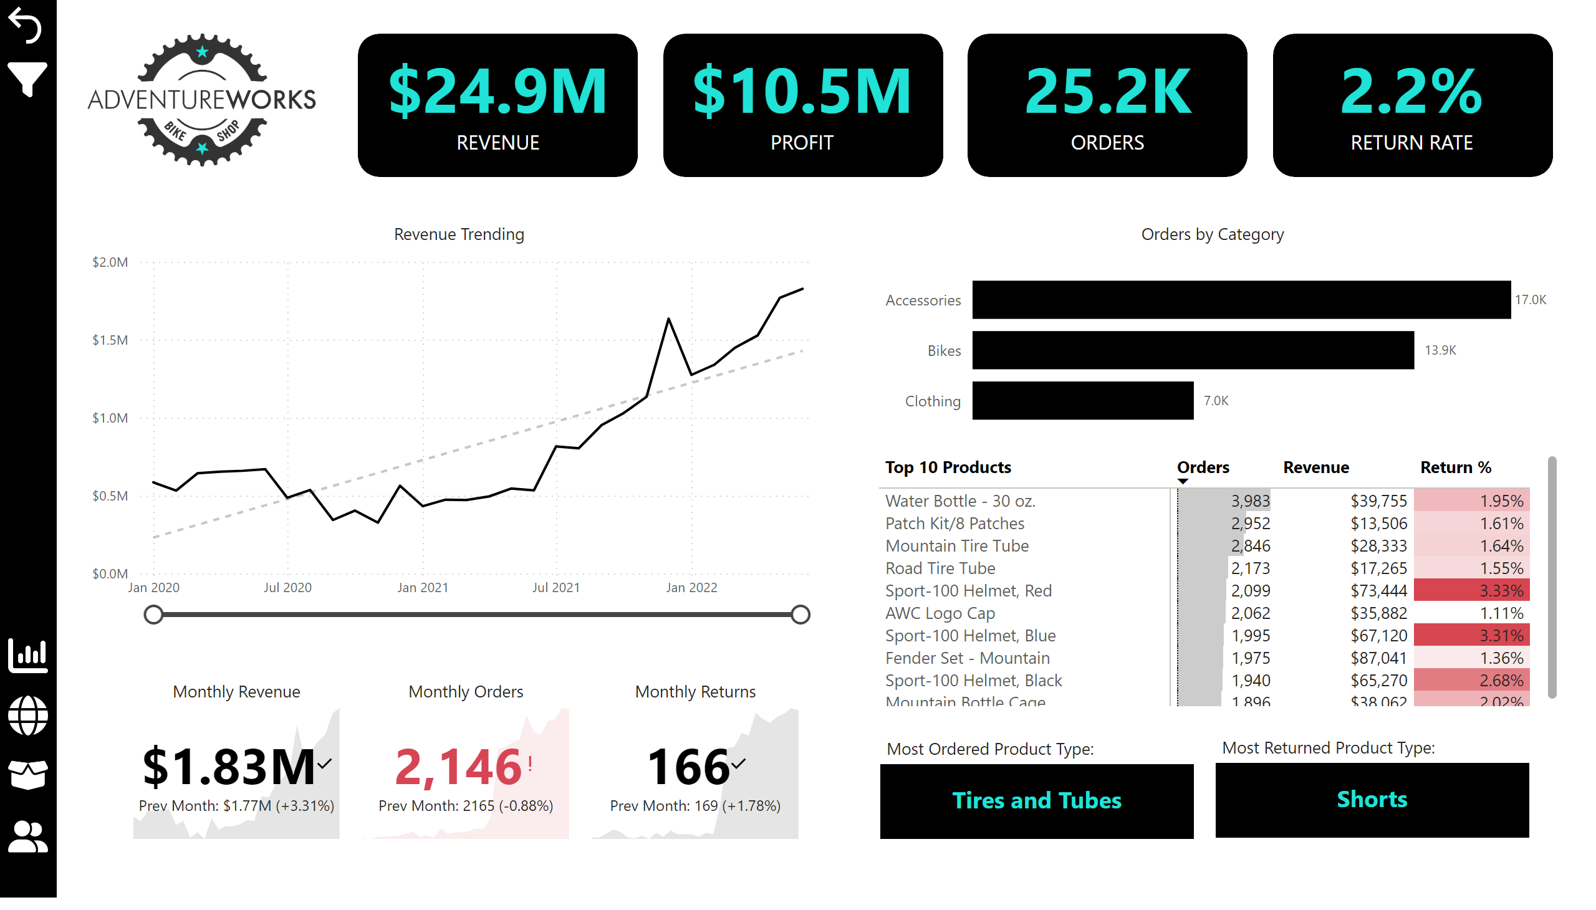
Exec Dashboard
Notes:
textbox
No alt text provided
actionButton
No alt text provided
Left Nav Background
No alt text provided
Revenue Trending
No alt text provided
shape
No alt text provided
actionButton
No alt text provided
shape
No alt text provided
Orders by Category
No alt text provided
card
No alt text provided
shape
No alt text provided
card
No alt text provided
actionButton
No alt text provided
pivotTable
No alt text provided
card
No alt text provided
actionButton
No alt text provided
AW Logo
No alt text provided
slicer
No alt text provided
card
No alt text provided
actionButton
No alt text provided
card
No alt text provided
shape
No alt text provided
Monthly Returns
No alt text provided
Monthly Revenue
No alt text provided
card
No alt text provided
shape
No alt text provided
slicer
No alt text provided
Monthly Orders
No alt text provided
actionButton
No alt text provided
actionButton
No alt text provided
textbox
No alt text provided

Slide 3
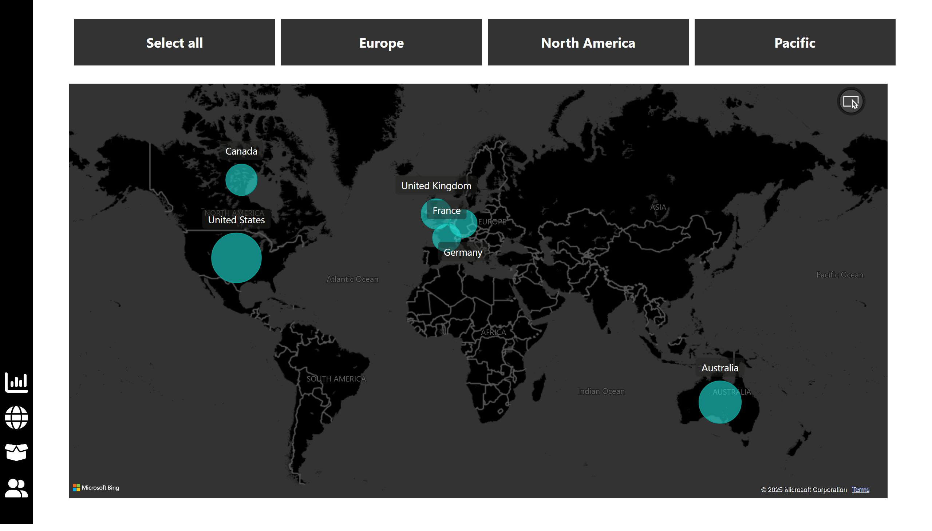
Map
Notes:
slicer
No alt text provided
actionButton
No alt text provided
shape
No alt text provided
actionButton
No alt text provided
map
No alt text provided
actionButton
No alt text provided
actionButton
No alt text provided

Slide 4
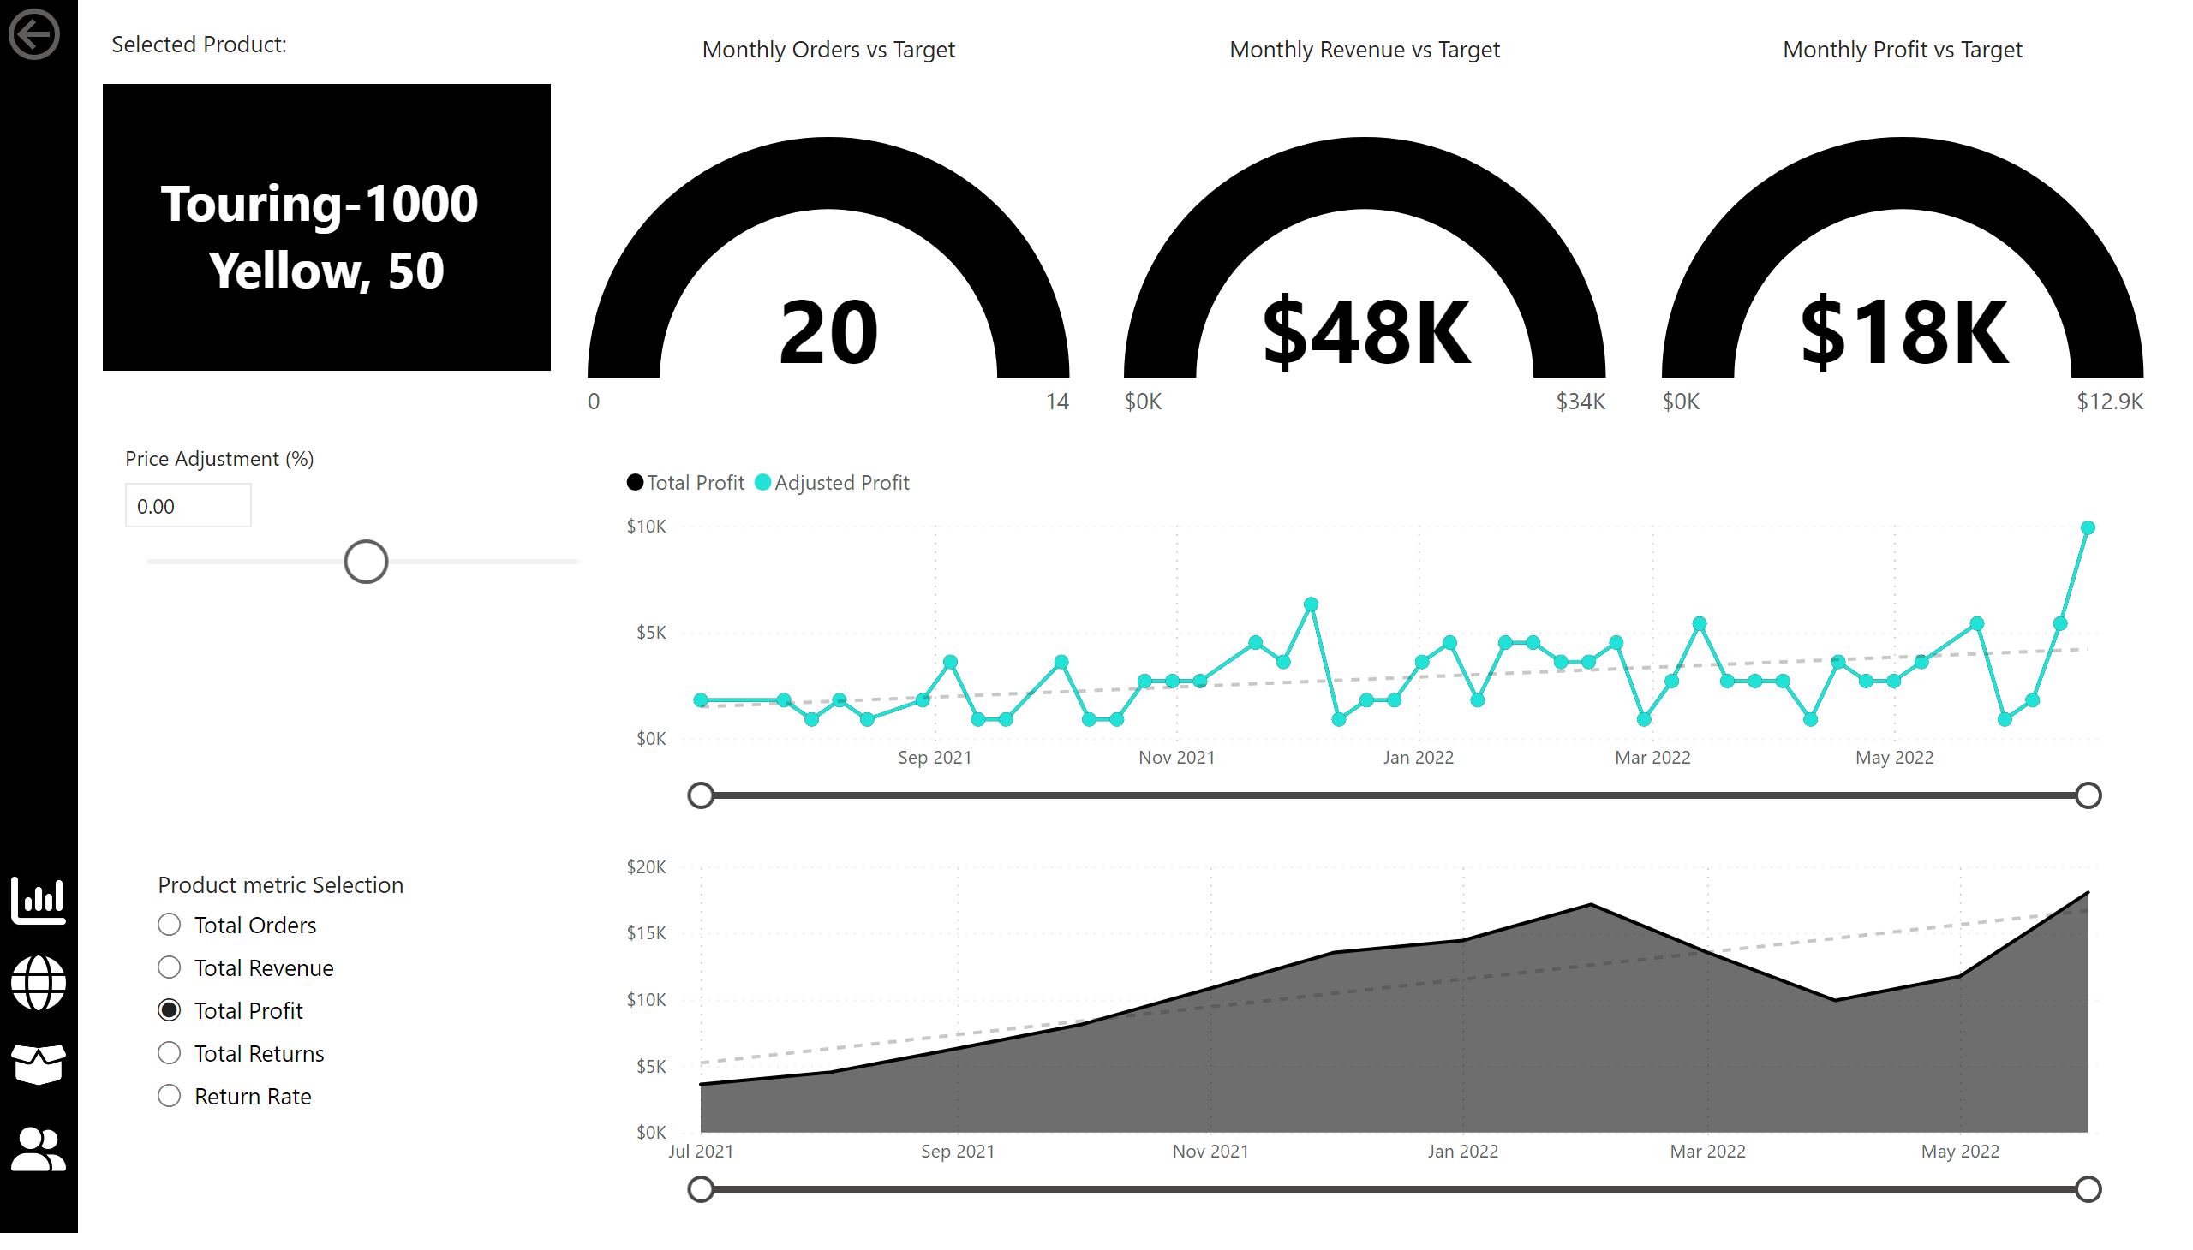
Product Detail
Notes:
actionButton
No alt text provided
Monthly Revenue vs Target
No alt text provided
shape
No alt text provided
card
No alt text provided
actionButton
No alt text provided
actionButton
No alt text provided
Return Trending
No alt text provided
Monthly Orders vs Target
No alt text provided
slicer
No alt text provided
Profit Trending
No alt text provided
actionButton
No alt text provided
slicer
No alt text provided
actionButton
No alt text provided
Monthly Profit vs Target
No alt text provided
textbox
No alt text provided

Slide 5
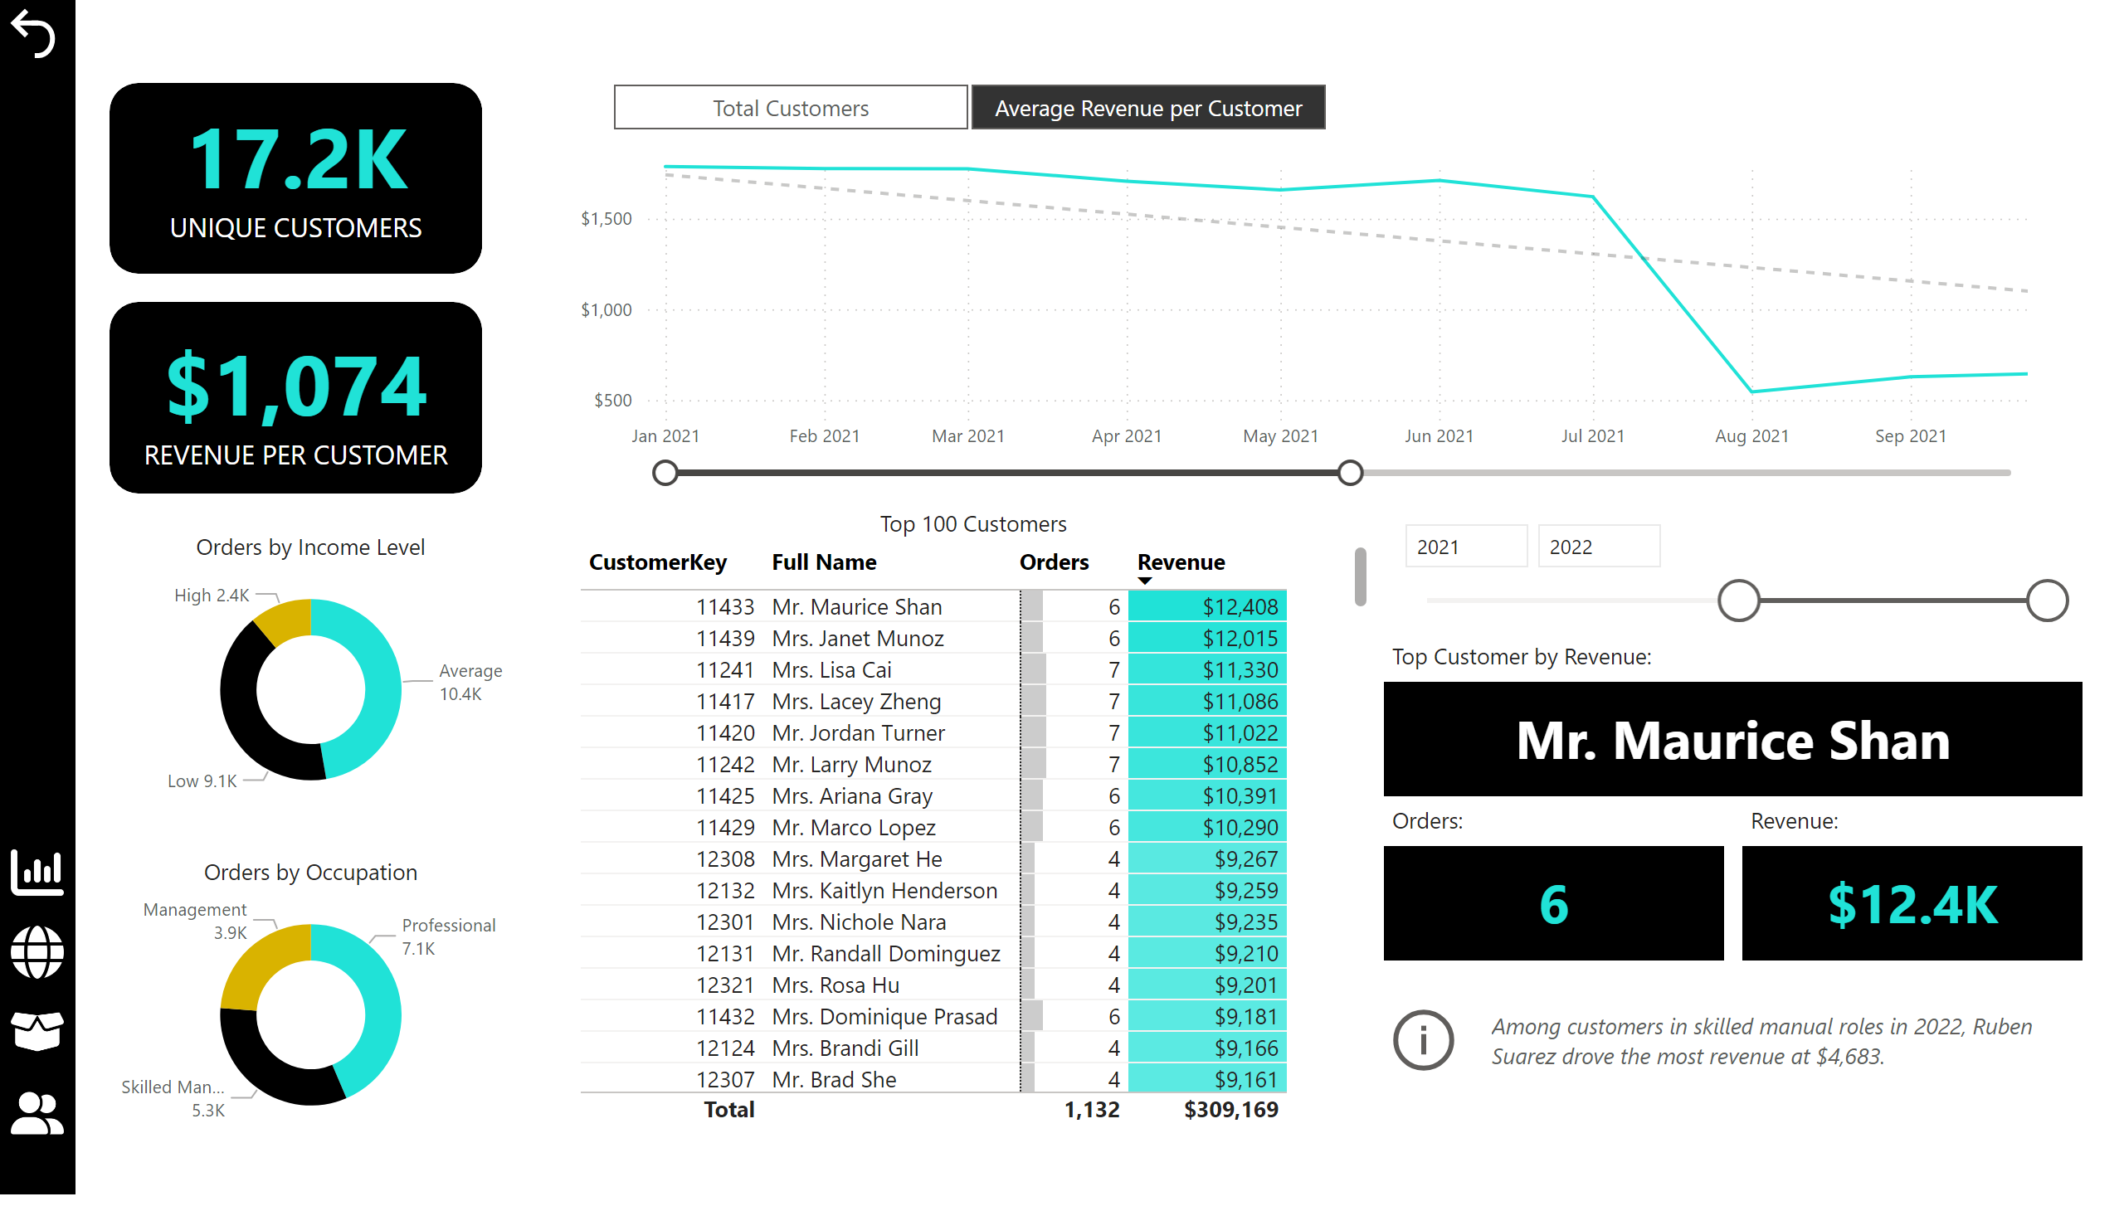
Customer Detail
Notes:
Average Revenue per Customer
No alt text provided
actionButton
No alt text provided
card
No alt text provided
actionButton
No alt text provided
card
No alt text provided
slicer
No alt text provided
card
No alt text provided
slicer
No alt text provided
actionButton
No alt text provided
Top 100 Customers
No alt text provided
textbox
No alt text provided
textbox
No alt text provided
textbox
No alt text provided
shape
No alt text provided
card
No alt text provided
actionButton
No alt text provided
actionButton
No alt text provided
actionButton
No alt text provided
Orders by Income Level
No alt text provided
Orders by Occupation
No alt text provided
shape
No alt text provided
card
No alt text provided
shape
No alt text provided

Slide 6
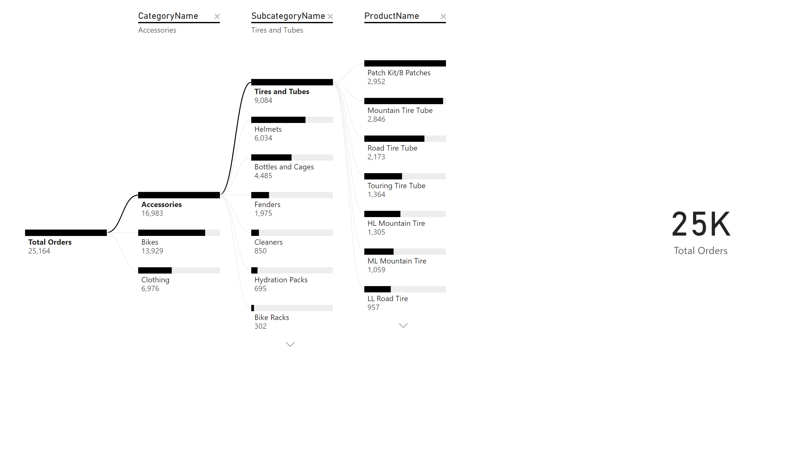
Decomposition Trees
Notes:
decompositionTreeVisual
No alt text provided
card
No alt text provided

Slide 7
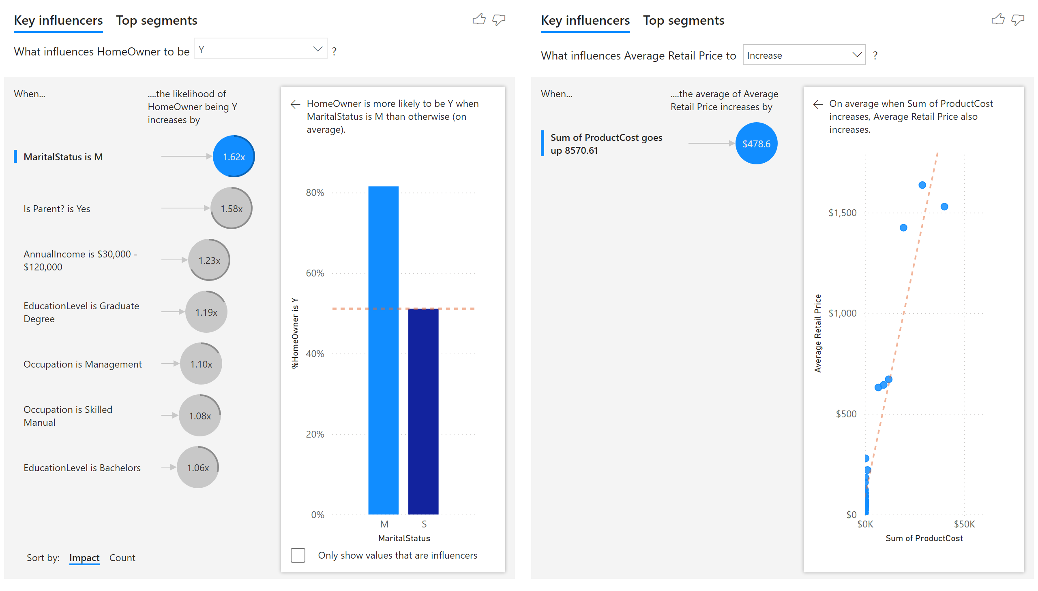
Key Influencers
Notes:
keyDriversVisual
No alt text provided
keyDriversVisual
No alt text provided

